Slide 1
Lab Notebook
Rachel Herman
EECT 111
Professor Alba Betancourt

Slide 2
Lab 1 –Resistor Variability
1/26/17
Jason Block, Rachel Herman
Purpose: Learn the how resistors vary using 20 resistors with the same color code.
Materials: 1 – Digital Multimeter GDM-8245, 20 resistors with the same color code.
Procedure: Select a set of 20, 1 k ohm resistors. Measure and record the resistance of each resistor.

Slide 3
Data:
Results:
Sample | Measured Value
1 | 1.002 KΩ
2 | .9822 KΩ
3 | .9963 KΩ
4 | .9909 KΩ
5 | 1.0182 KΩ
6 | .9819 KΩ
7 | .9903 KΩ
8 | .9969 KΩ
9 | .9965 KΩ
10 | .9819 KΩ
11 | .9792 KΩ
12 | .9807 KΩ
13 | .9918 KΩ
14 | .9866 KΩ
15 | .9828 KΩ
16 | .9792 KΩ
17 | .9845 KΩ
18 | .9788 KΩ
19 | 1.0055 KΩ
20 | .9923 KΩ
Resistor color code = ­­­­­­­­­­­­­­­__Brown – Black – Red - Gold_
Resistor value = __1 KΩ________________________
Resistor tolerance = ___+/- 5%__________________
Smallest resistance = ­­­­­­­­­­­­­­­___.9788 KΩ_________________
Largest resistance = ___1.0182 KΩ_________________
Average resistance = __.99045 KΩ__________________
Standard Deviation = __.010457376 KΩ______________
Do any of your resistor values exceed the part tolerance? _NO___
+/- 5% = .950 to 1.05 KΩ
Observations: We observed the precise resistance of (20) 1 KΩ resistors to the ten-thousandth KΩ._We measured ohms with a digital multimeter . The standard deviation came to .010457376 KΩ.

Slide 4
Lab 2 – Reading and Sorting Resistors
2/2/17
Jason Block, Rachel Herman
Purpose: Learn the resistor color code using 15 resistors which must be sorted from smallest to largest value.
Materials: 1 – Digital Multimeter GDM-8245, 15 unique resistors
Procedure: Build a resistor kit that includes 15 resistors and, sort resistors based on color code from smallest to largest and measure the resistance of each resistor and verify sorting

Slide 5
Data:
 | Color Code | Measured Value
100 = | Brown, Black, Brown | 98.47Ω
220 = | Red, Red, Brown | 216.13 Ω
330 = | Orange, Orange, Brown | 323.45 Ω
470 = | Yellow, Violet, Brown | 464.76 Ω
1K = | Brown, Black, Red | .9781 k Ω
2.2K = | Red, Red, Red | 2.168 k Ω
3.3K = | Orange, Orange, Red | 3.245 k Ω
4.7K = | Yellow, Violet, Red | 4.618 k Ω
10K = | Brown, Black, Orange | 9.740 k Ω
22K = | Red, Red, Orange | 21.56 k Ω
33K = | Orange, Orange, Orange | 32.81 k Ω
47K = | Yellow, Violet, Orange | 46.37 k Ω
100K = | Brown, Black, Yellow | 98.10 k Ω
1M = | Brown, Black, Green | 1.006 MΩ
10M = | Brown, Black, Blue | 10.25 MΩ
Observations: We measured the resistance of each resistor and wrote down the color code. We found that each resistor was close to being what the color code said should be the resistance. While measuring we switched the units to Ohms, K Ohms, or M Ohms.

Slide 6
Lab 3 – Series Resistors
2/9/17
Jason Block, Rachel Herman
Purpose: Experiment with series circuits and verify that the simulation, analysis (calculations) and test results all agree.
Materials: 1 – Digital Multimeter GDM-8245, DC Power Supply HY1802D Set at 9V DC, 3 resistors (10K, 2.2K, 4.7K)
Procedure: Measure and record the value of each resistor. Connect the resistors as shown in Figure 1. Measure and record the total resistance, RT. Then connect the resistors as shown in Figure 2, the 9V come from the DC power supply. Then measure and record with the Digital Multimeter the current and voltages of the series circuit.

Slide 7
Figure 1
Figure 2
 | Measured | Calculated | Simulated
R1 = | 9.779 kΩ | 10 kΩ | 10 kΩ
R2 = | 2.186 kΩ | 2.2 kΩ | 2.2 Ω
R3 = | 4.621 kΩ | 4.7 kΩ | 4.7 kΩ
RT = | 16.586 kΩ | 16.9 kΩ | 16.9 kΩ
 | Measured | Calculated | Simulated
IT = | 5.235 µA | 5.325 µA | 5.325 µA
V1 = | 9.094 V | 8.9908 V | 9 V
VA = | 3.7307 V | 3.6708 V | 3.675 V
VB = | 2.5322 V | 2.5004 V | 2.503 V
Observations: Using a bread board, we connected 9 V of DC currant and three different resistors in series with a ground. We measured each exact value of each resistor along with the exact voltage from our power source and recorded our findings in the first table. For the second table we measured the voltage across the total circuit, across the second and third resistor, and across just the third resistor to get V1, VA, and VB. Our findings were slightly different than the calculated and simulated values, but they were close.

Slide 8
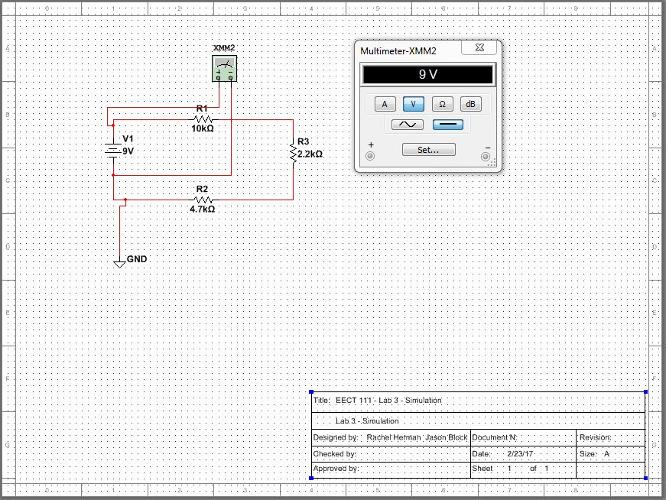
Multisim – Lab 3

Slide 9
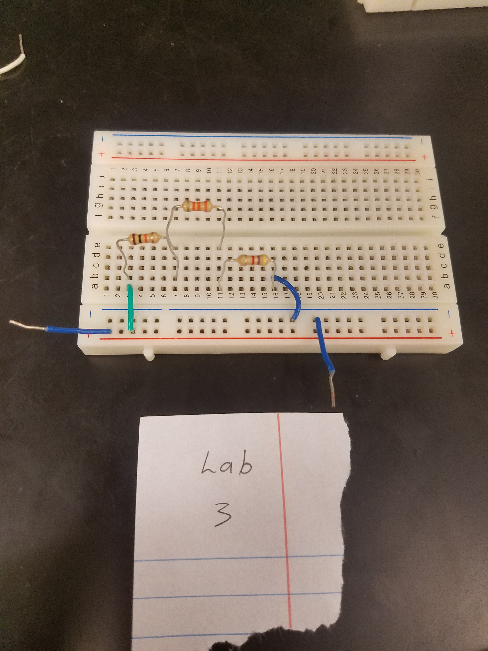
Pictures – Lab 3

Slide 10
Lab 4 – Black Box Design
2/16/17
Jason Block, Rachel Herman
Purpose: Learn about series circuits
Materials: 1 – Digital Multimeter, DC Power Supply HY1802D Set at 9V DC, 3 – Standard Resistor
Procedure: The voltage applied to a Black Box is 9V and the measured current draw is 10mA. Design a 3 resistor series circuit that meets the voltage and current requirements using “standard” resistor value.

Slide 11
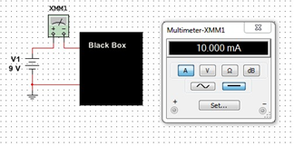
Figure 1
 | Design | Measured | Calculated | Simulated
V1 = | 9V | 9.104V | 9V | 9V
IT = | 10mA | 10mA | 10mA | 10mA
RT = | 900 ohm | 885.56 ohm | 900 ohm | 900 ohm
R1 = | 100 ohm | 98.46 ohm | 100 ohm | 100 ohm
R2 = | 330 ohm | 324.3 ohm | 330 ohm | 330 ohm
R3 = | 470 ohm | 462.8 ohm | 470 ohm | 470 ohm
Observations: We created a series circuit using a 9 DCV power source and 3 resistors. One 100ohm, one 330ohm, and one 470ohm, for a grand total resistance of 900ohm which matched our calculations for total resistance. After setting up the circuit on a bread board, grounding it, and applying 9v of DC currant, we measured the total resistance as well as the resistance of each resistor to find that each were well within the 5% tolerance allotment.

Slide 12
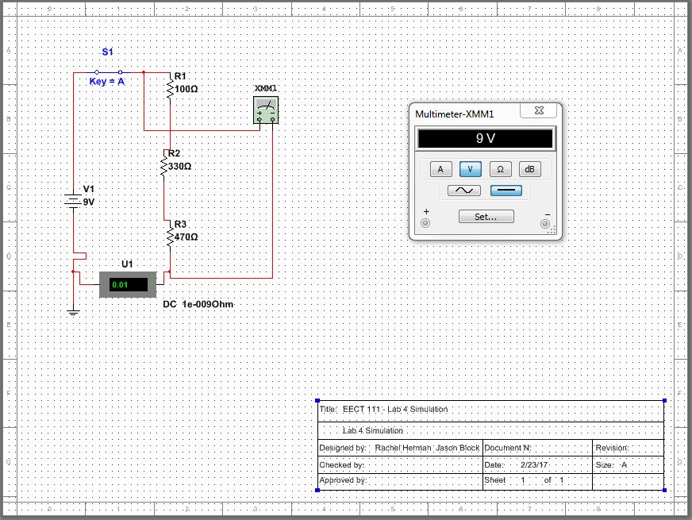
Multisim – Lab 4

Slide 13
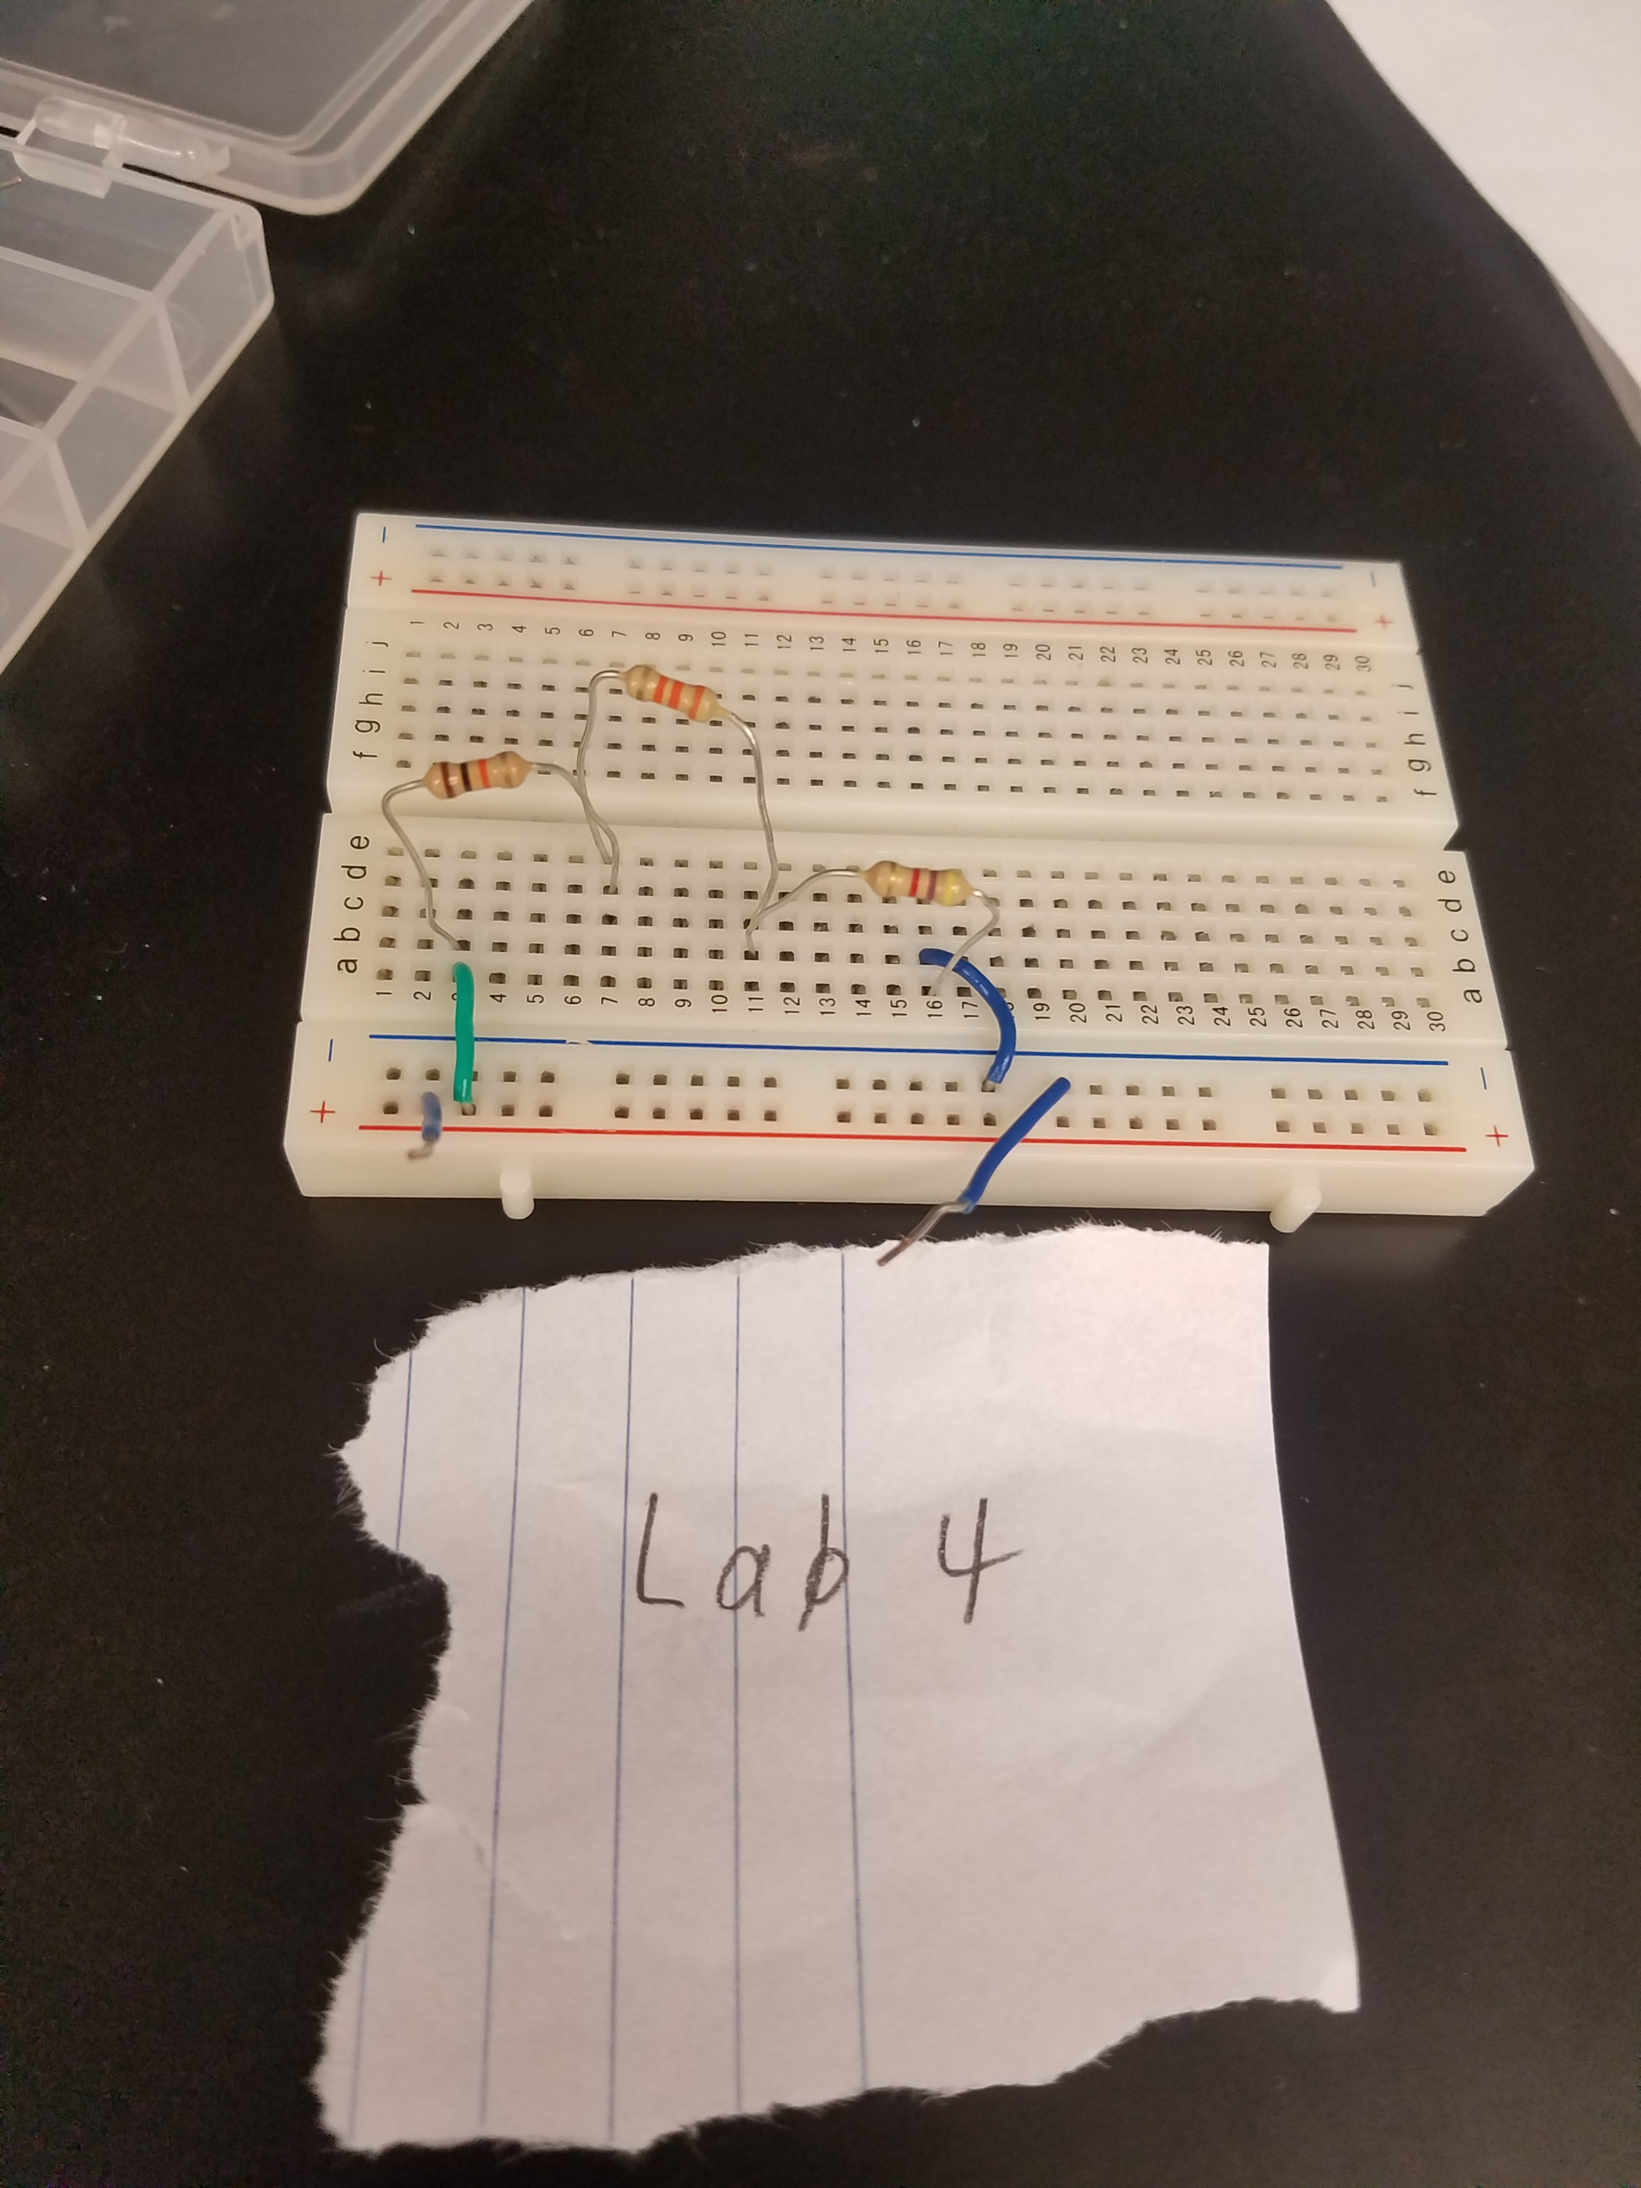
Pictures – Lab 4

Slide 14
Lab 6 – Black Box Design
2/23/17
Jason Block, Rachel Herman
Purpose: Learn about parallel circuits
Materials: 1 – Digital Multimeter, DC Power Supply HY1802D Set at 9V DC, 2 – Standard Resistor
Procedure: The voltage applied to a Black Box is 9V and the measured current draw is 18mA. Design a 2 resistor series circuit that meets the voltage and current requirements using “standard” resistor value.

Slide 15
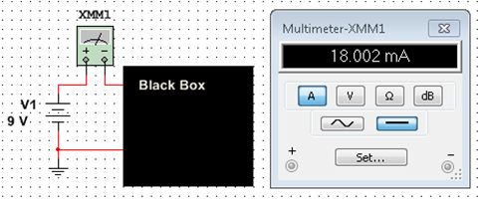
Figure 1
 | Design | Measured | Calculated | Simulated
V1 = | 9V | 9.124V | 9V | 9V
IT = | 18 mA | 20 mA | 18 mA | 18 mA
RT = | .5 kΩ | .4919 kΩ | .5 kΩ | .5 kΩ
R1 = | 1 kΩ | .9868 kΩ | 1 kΩ | 1kΩ
R2 = | 1 kΩ | .9808 kΩ | 1 kΩ | 1 kΩ
Observations: In this lab we connected a 9V DC power source to a parallel circuit with two resistors on a bread board. These resistors were both 1 kΩ. All of our results from our testing in the lab were accurate compared to our simulation and calculations. We calculated the total currant to be 18 mA. Our resistors were within the labeled accuracy and our total resistance was within what we calculated.

Slide 16
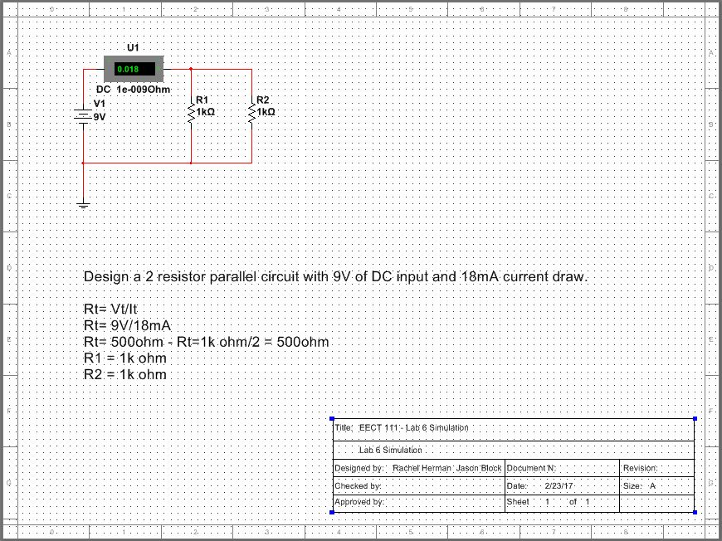
Multisim – Lab 6

Slide 17
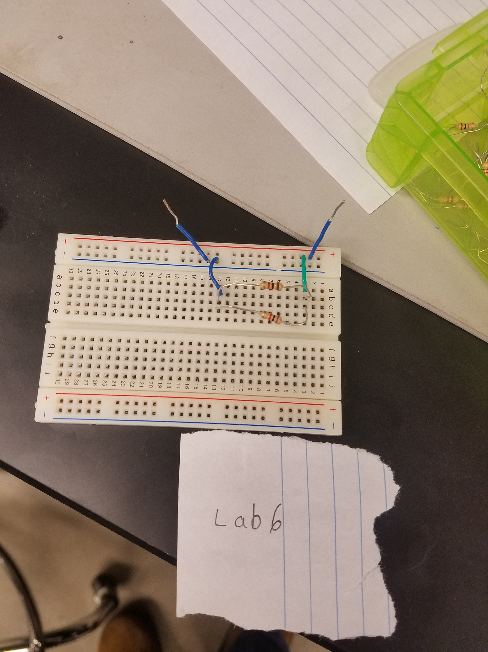
Pictures – Lab 6

Slide 18
Lab 7 – 4 Resistor Parallel Circuit
2/23/17
Jason Block, Rachel Herman
Purpose: Learn about parallel circuits
Materials: 1 – Digital Multimeter, DC Power Supply HY1802D Set at 9V DC, 3 – Standard Resistor
Procedure: The voltage applied to 4 parallel resistors is 9V. Measure all the resistor values, total current and all the branch currents

Slide 19
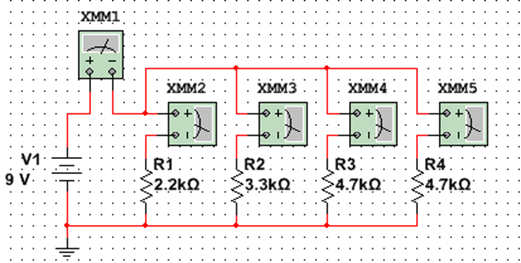
Figure 1
Table 2
Table 1
 | Measured | Calculated | Simulated
V1 = | 9.11 V | 9 V | 9 V
RT = | .8338 kΩ | .8452 kΩ | .8452 kΩ
I1 = | .4 µA | .409 µA | .3458 µA
I2 = | .26 µA | .272 µA | .2305 µA
I3 = | .2 µA | .191 µA | .1619 µA
I4 = | .2 µA | .191 µA | .1619 µA
IT = | 1.06 µA | 1.064 µA | .9001 µA
 | Design | Measured
R1 = | 2.2 kΩ | 2.182 kΩ
R2 = | 3.3 kΩ | 3.243 kΩ
R3 = | 4.7 kΩ | 4.621 kΩ
R4 = | 4.7 kΩ | 4.61 kΩ
Observations: In this lab we simulated a parallel circuit with four branches with one resistor each, entering the measured value of each resistor into Table 1. After finding our simulation results we created this circuit in the lab using a bread board and the four values of resistors required. Our measurements, recorded in Table 2, showed us that the amp value decreases the farther you get down the line of branches.

Slide 20
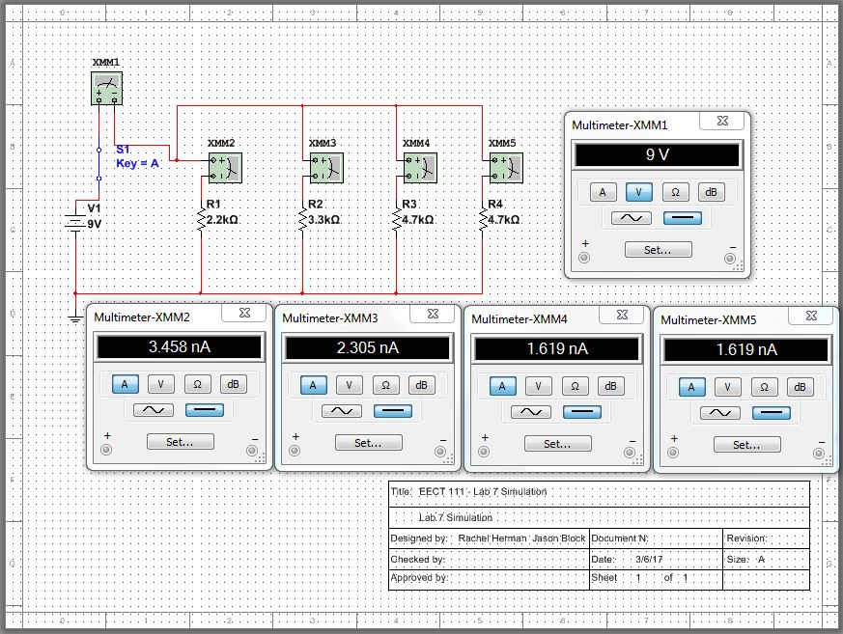
Multisim – Lab 7

Slide 21
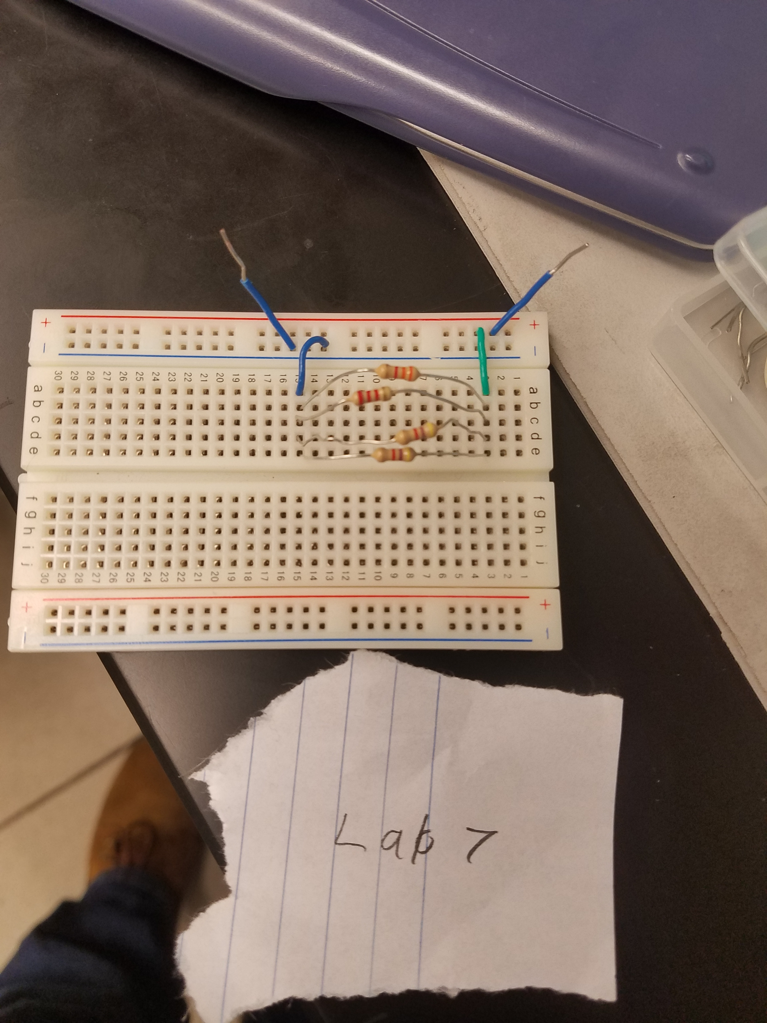
Pictures – Lab 7

Slide 22
Lab8 – Black Box 3 Design
3/2/17
Jason Block, Rachel Herman
Purpose: Learn about building a circuit that produces exactly 1.3V
Materials: 1 – Digital Multimeter, DC Power Supply HY1802D Set at 9V DC, 5 – Standard Resistor, 1 – 5 K ohm pot
Procedure: Using at least 3 equal value resistors (in the Black Box) design a circuit that produces an output voltage of 1.3V. Then adjust R1 so that the output voltage is exactly 1.3V.

Slide 23
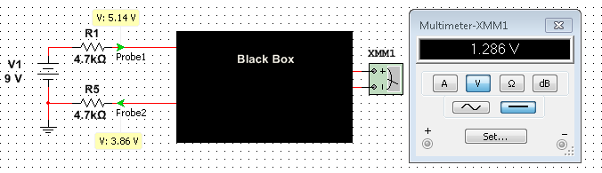
 | Design | Measured
R1 = | 4.7kohm | 4.636kohm
R2 = | 4.7kohm | 4.636kohm
R3 = | 4.7kohm | 4.639kohm
R4 = | 4.7kohm | 4.625kohm
R5 = | 4.7kohm | 4.596kohm
R(Black Box) = | 1.56kohm | 1.543kohm
R1adj = | 43ohm | 43.62ohm
 | Measured | Calculated | Simulated
V1 = | 9.065V | 9V | 9V
VA = | 5.189V | 5.14V | 5.143V
VB = | 3.891V | 3.86V | 3.867V
VA - VB = | 1.296V | 1.28V | 1.286V
(VA - VB) adj = | 2.261V | 2.24V | 2.235V
Observations: In this lab we calculated the three mystery resistors as 4.7kohms each and then set them up on the circuit in parallel. As the resistors were added in parallel, the voltage dropped, yet the voltage stayed consistent across the parallel section of the circuit. After we took these measurements of voltage at various parts of the circuit, we replaced resistor 1 with an adjustable resistor and did our voltage measurements and calculations again.

Slide 24
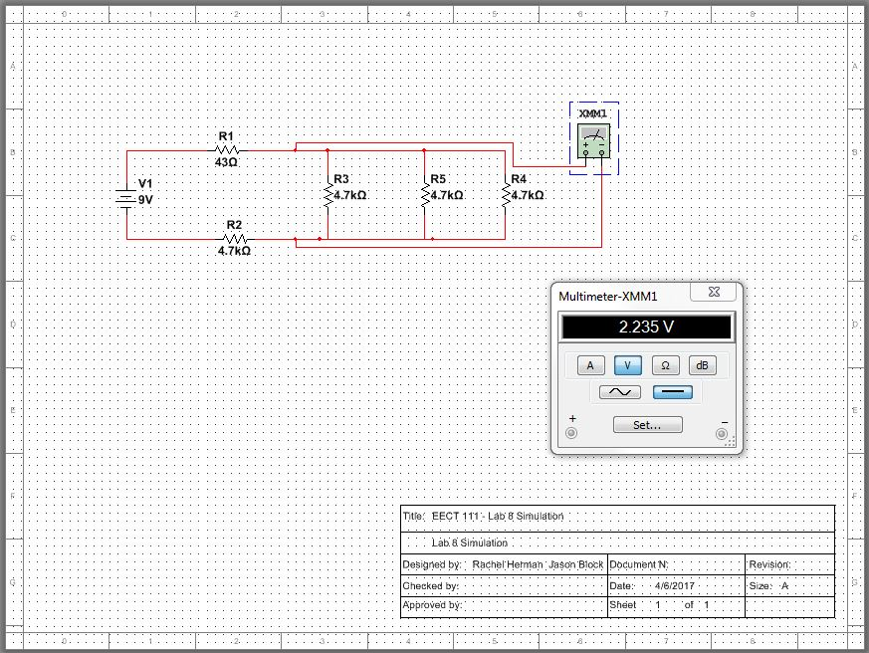
Multisim – Lab 8

Slide 25
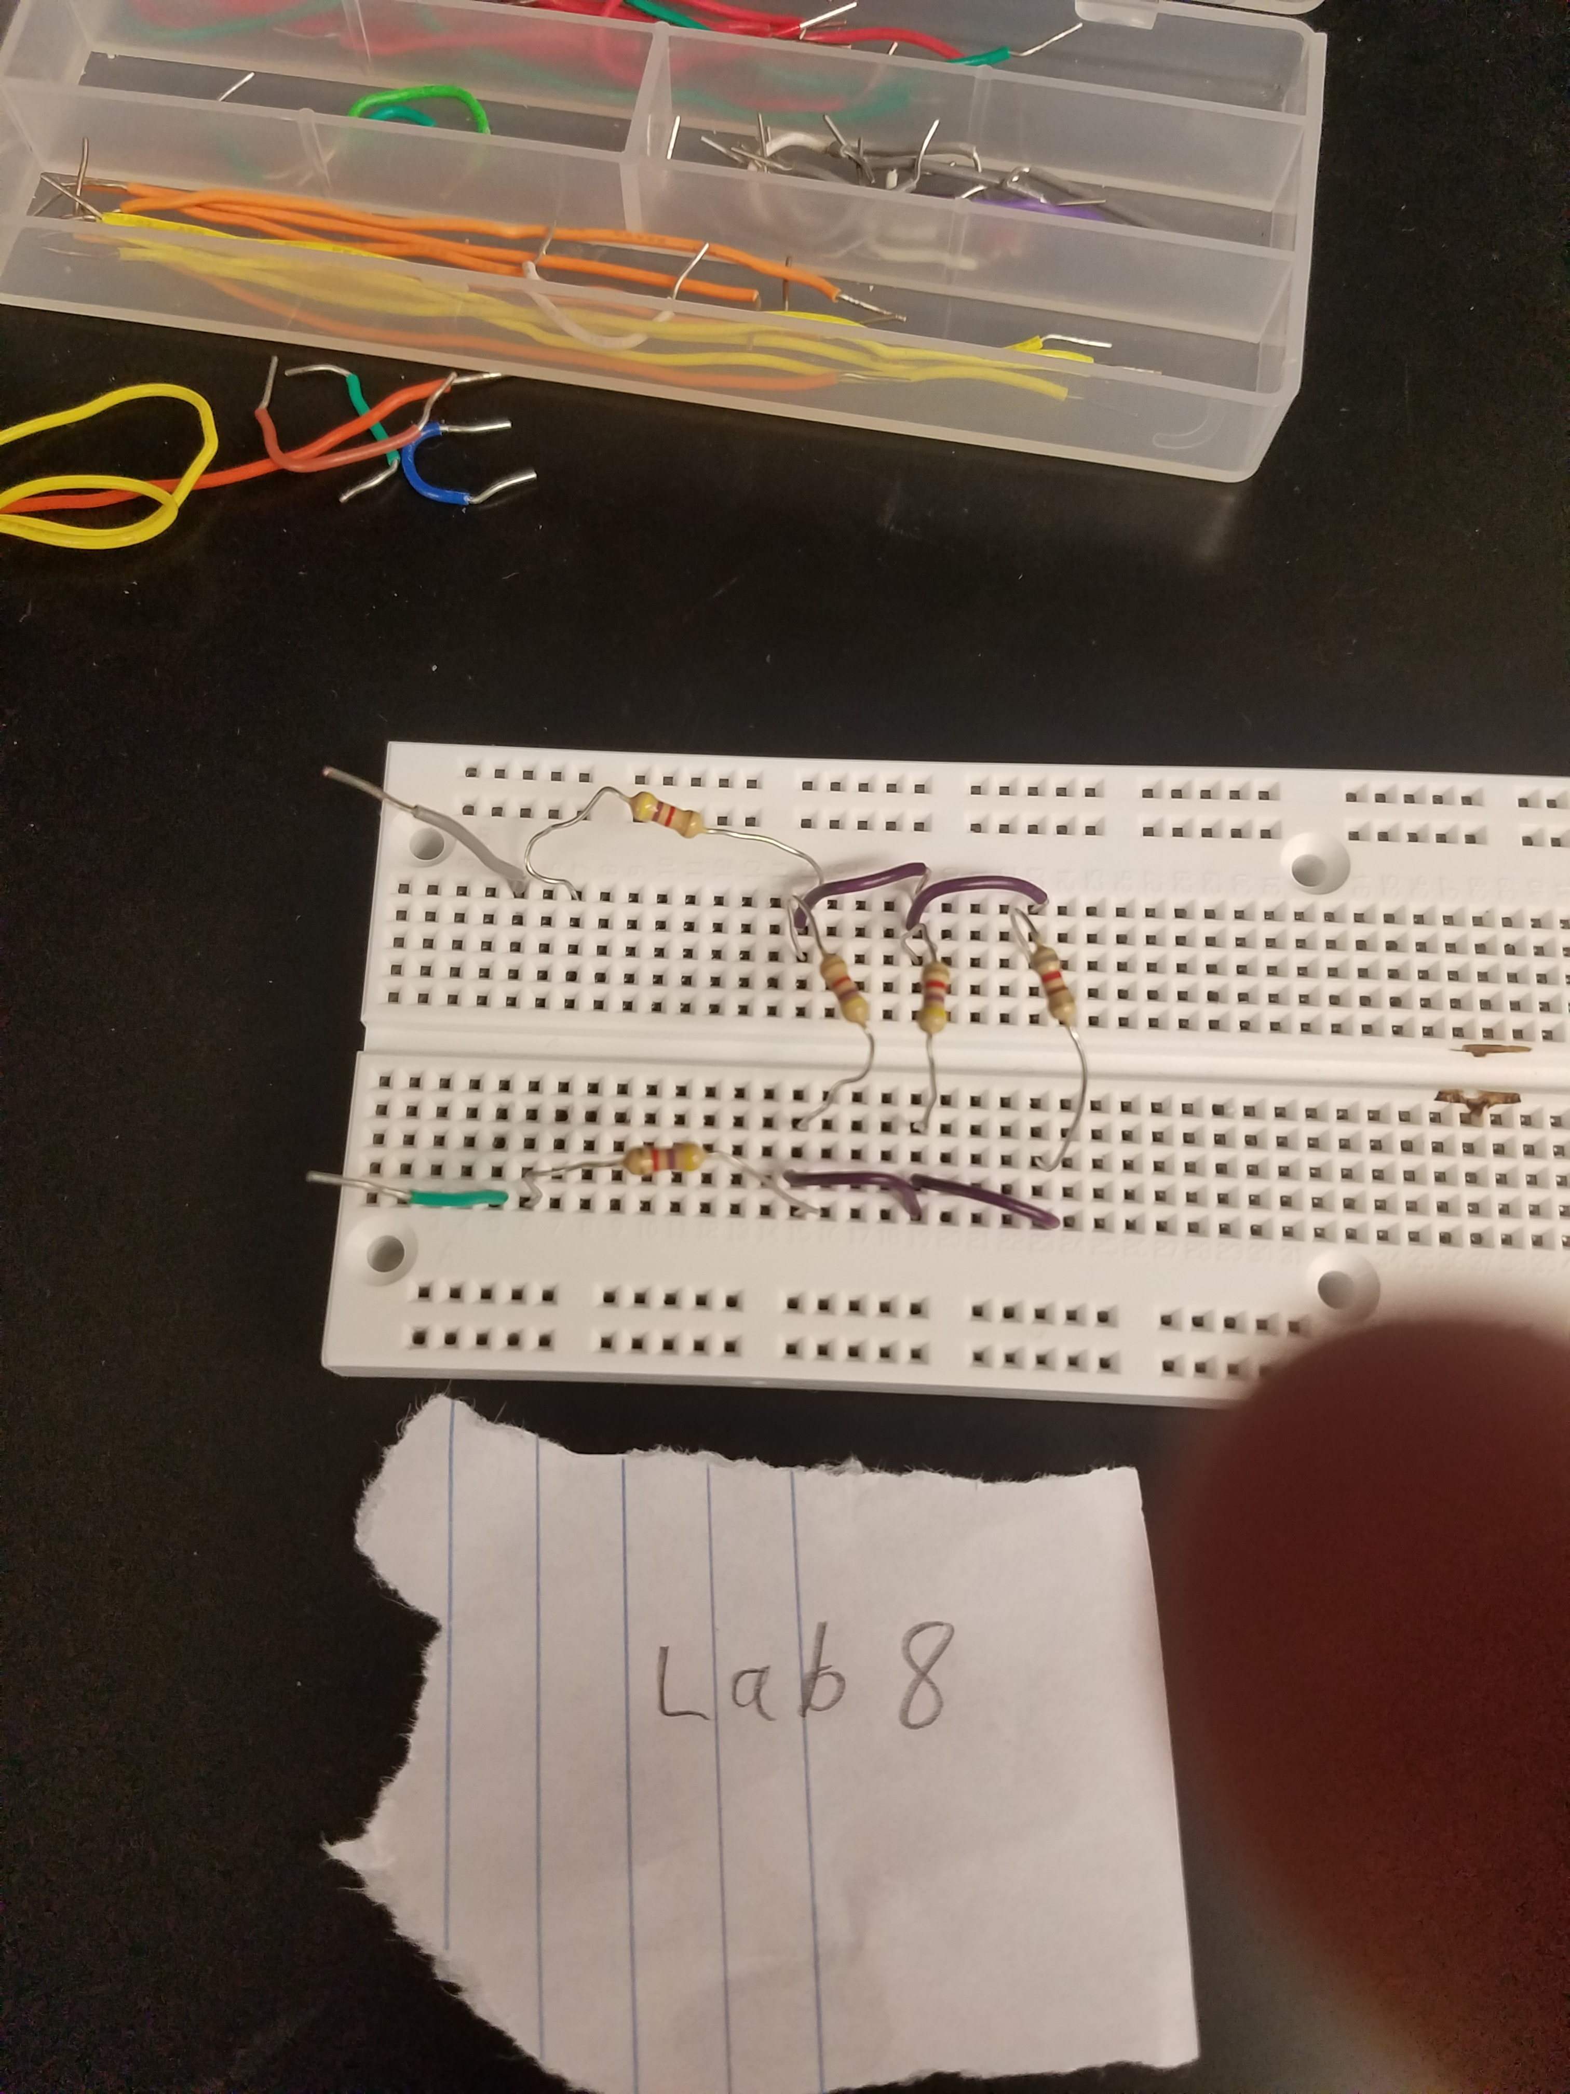
Pictures – Lab 8

Slide 26
Lab 9 – Series/Parallel Resistors
3/23/17
Jason Block, Rachel Herman
Purpose: Experiment with series circuits and verify that the simulation, analysis (calculations) and test results all agree.
Materials: 1 – Digital Multimeter, DC Power Supply HY1802D Set at 9V DC, 8 resistors: 2 each 470Ω, 2 each 1kΩ, and 1 each of the following:
2.2kΩ, 3.3kΩ, 4.7kΩ, 10kΩ
Procedure: Measure and record the value of each resistor. Connect the resistors as shown in Figure 1. Measure and record the total resistance, RT. Then connect the resistors as shown in Figure 2, the 9V come from the Elvis II (Modular Engineering Educational Laboratory Platform). Then measure and record with the Digital Multimeter the current and voltages of the series circuit

Slide 27
Figure 1
Figure 2
 | Expected | Measured
R1 = | 470ohm | 464.6ohm
R2 = | 470ohm | 459.4ohm
R3 = | 1kohm | .9986kohm
R4 = | 1kohm | .9794kohm
R5 = | 2.2kohm | 2.161kohm
R6 = | 3.3kohm | 3.236kohm
R7 = | 4.7kohm | 4.58kohm
R8 = | 10kohm | 9.809kohm
 | Calculated | Simulated | Measured
V1 = | 9V | 9V | 9.093V
IT = | 9.7656mA | 9.766mA | 9.851mA
VA = | 4.59V | 4.59V | 4.685V
VB = | 4.219V | 4.219V | 4.266V
VC = | 3.825V | 3.825V | 3.862V
Adjust R2 so that the VA voltage is equal to 4.5V. Then measure the value of the new R2 and calculate and simulate a value that would produce the 4.5V.
 | Calculated | Simulated | Measured
R34 = | .5kohm | .5kohm | .4743kohm
R567 = | 1.031kohm | 1.031kohm | .9261kohm
R345678 = | 11.531kohm | 11.531kohm | 10.985kohm
R2345678 = | .4516kohm | .4516kohm | .4421kohm
RT = | .9216kohm | .9216kohm | .9072kohm
 | Measured | Simulated | Calculated
VA = | 4.516V | 4.5V | 4.5V
R2 = | .4852kohm | .490kohm | .490kohm

Slide 28
Observations: In this lab we set up a circuit with both parallel and series branches. We calculated the voltage drops as well as total resistance and resistance in certain branches. After measuring each resistor we set them up as the simulation showed. The Multisim simulation matched our calculation as well as fairly close to our measurements. In the second part of the lab we were instructed to find a resistor that would give value VA a measure of 4.5V. We calculated that a resistor of 490 ohms would do the trick and after putting it in series the simulation and measurements showed us we were right.

Slide 29
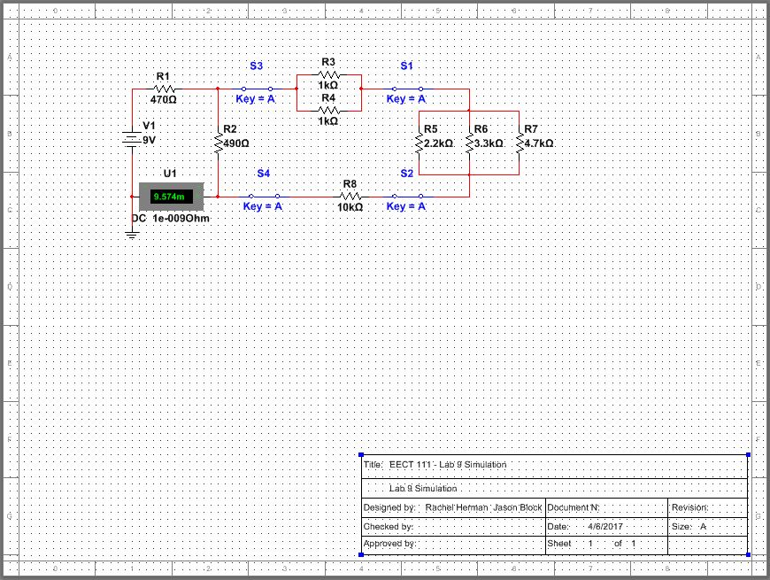
Multisim – Lab 9

Slide 30
Lab 10 – Series/Parallel Capacitors
4/20/17
Jason Block, Rachel Herman
Purpose: Experiment with series circuits and parallel combinations of capacitors.
Materials: 1 – LCR Meter – LCR-819, 1 each of the following: 10uF, 22uF and 47uF
Procedure: Measure and record the capacitance of each capacitor using the LCR meter. Connect the capacitors as shown in Figure 1 and measure and record the total capacitance, CT. Then connect the capacitors as shown in Figure 2 and measure and record the total capacitance, CT.

Slide 31
Figure 1
Figure 2
 | Expected | Measured
C1 = | 10 uF | 7.342 uF
C2 = | 22 uF | 19.470 uF
C3 = | 47 uF | 37.562 uF
CT = | 5.9 uF | 4.678 uF
 | Expected | Measured
C1 = | 10 uF | 6.865 uF
C2 = | 22 uF | 20.466 uF
C3 = | 47 uF | 46.212 uF
CT = | 5.9 uF | 5.964 uF
Observations: In this lab we measured the values of capacitors using an LCR meter. The measured values from the LCR meter were a bit lower than the expected values for the series and parallel circuits. The total value was a bit less than the expected value that we got from using equations from the book.

Slide 32
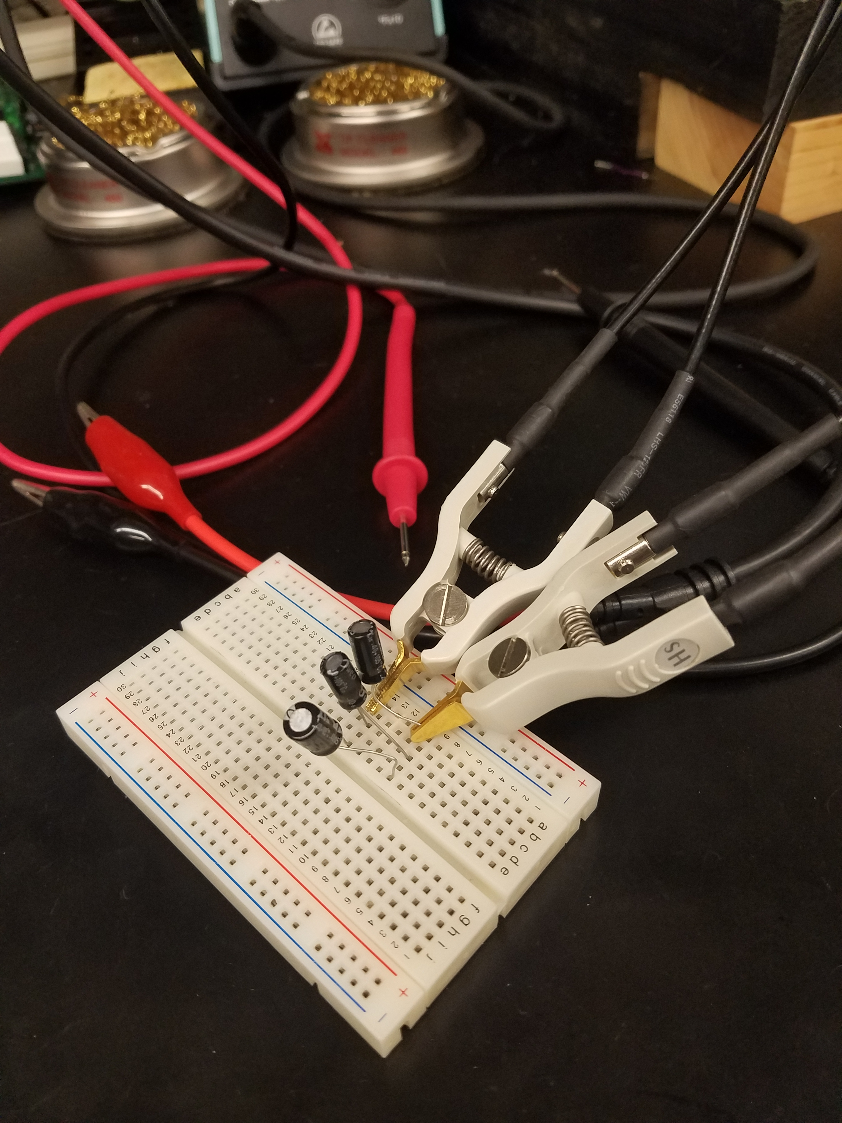
Pictures – Lab 10

Slide 33
Lab 11 – RC Lab
4/27/17
Jason Block, Rachel Herman
Purpose: Experiment with RC (Resistor & Capacitor) circuits.
Materials: Digital Multimeter, LCR Meter – LCR-819, Oscilloscope – TDS-220, Function Generator – GFG-8210, 1 – 1kΩ resistor, 1 each of the following: 0.47uF, 1uF and 2.2uF
Procedure: Measure and record the resistor value using the DMM and measure and record the capacitor values using the LCR meter in Table 1. Connect the resistor and capacitor as shown in Figure 1. Connect the Function Generator to the input at V1 and connect Channel 1 of the Oscilloscope to the input and Channel 2 to the output. Adjust the voltage of the Function Generator to 1Vpp at the frequencies shown in Table 2. Measure the input and output voltages using the Oscilloscope. Record the results in Table 2. Change the capacitor and retest.

Slide 34
Figure 1
 | Output Voltage C = 0.47 µf |  |  | Output Voltage C = 1µf |  |  | Output Voltage C = 2.2 µf
 | Expected | Measured |  | Expected | Measured |  | Expected | Measured
Frequency | Output Voltage | Input Voltage | Output Voltage | Output Voltage | Input Voltage | Output Voltage | Output Voltage | Input Voltage | Output Voltage
10 | 0.9995 V | 1.0094 V | 0.9996 V | 0.9980 V | 1.0094 V | 0.9981 V | 0.9905 V | 1.0094 V | 0.9924 V
50 | 0.9892 V | 1.0094 V | 0.9901 V | 0.9540 V | 1.0094 V | 0.9566 V | 0.8227 V | 1.0094 V | 0.8587 V
100 | 0.9590 V | 1.0094 V | 0.9623 V | 0.8468 V | 1.0094 V | 0.8541 V | 0.5863 V | 1.0094 V | 0.6423 V
200 | 0.8611 V | 1.0094 V | 0.8705 V | 0.6228 V | 1.0094 V | 0.6344 V | 0.3402 V | 1.0094 V | 0.3864 V
300 | 0.7486 V | 1.0094 V | 0.7627 V | 0.4688 V | 1.0094 V | 0.4801 V | 0.2345 V | 1.0094 V | 0.2691 V
400 | 0.6463 V | 1.0094 V | 0.6625 V | 0.3698 V | 1.0094 V | 0.3796 V | 0.1780 V | 1.0094 V | 0.2051 V
500 | 0.5609 V | 1.0094 V | 0.5776 V | 0.3034 V | 1.0094 V | 0.3119 V | 0.1432 V | 1.0094 V | 0.1653 V
600 | 0.4916 V | 1.0094 V | 0.5079 V | 0.2565 V | 1.0094 V | 0.2639 V | 0.1197 V | 1.0094 V | 0.1383 V
700 | 0.4356 V | 1.0094 V | 0.4511 V | 0.2218 V | 1.0094 V | 0.2283 V | 0.1028 V | 1.0094 V | 0.1188 V
800 | 0.3899 V | 1.0094 V | 0.4045 V | 0.1952 V | 1.0094 V | 0.2011 V | 0.0901 V | 1.0094 V | 0.1041 V
900 | 0.3523 V | 1.0094 V | 0.3659 V | 0.1742 V | 1.0094 V | 0.1794 V | 0.0801 V | 1.0094 V | 0.0927 V
1,000 | 0.3208 V | 1.0094 V | 0.3335 V | 0.1572 V | 1.0094 V | 0.1619 V | 0.0721 V | 1.0094 V | 0.0835 V
2,000 | 0.1670 V | 1.0094 V | 0.1742 V | 0.0793 V | 1.0094 V | 0.0818 V | 0.0361 V | 1.0094 V | 0.0418 V
3,000 | 0.1122 V | 1.0094 V | 0.1171 V | 0.0531 V | 1.0094 V | 0.0546 V | 0.0241 V | 1.0094 V | 0.0279 V
4,000 | 0.0843 V | 1.0094 V | 0.0881 V | 0.0397 V | 1.0094 V | 0.0411 V | 0.0181 V | 1.0094 V | 0.0209 V
5,000 | 0.0676 V | 1.0094 V | 0.0705 V | 0.0318 V | 1.0094 V | 0.0328 V | 0.0144 V | 1.0094 V | 0.0167 V
6,000 | 0.0563 V | 1.0094 V | 0.0587 V | 0.0265 V | 1.0094 V | 0.0273 V | 0.0121 V | 1.0094 V | 0.0139 V
7,000 | 0.0483 V | 1.0094 V | 0.0504 V | 0.0227 V | 1.0094 V | 0.0234 V | 0.0103 V | 1.0094 V | 0.0119 V
8,000 | 0.0423 V | 1.0094 V | 0.0441 V | 0.0199 V | 1.0094 V | 0.0205 V | 0.0091 V | 1.0094 V | 0.0104 V
9,000 | 0.0376 V | 1.0094 V | 0.0392 V | 0.0176 V | 1.0094 V | 0.0182 V | 0.0081 V | 1.0094 V | 0.0093 V
10,000 | 0.0338 V | 1.0094 V | 0.0353 V | 0.0159 V | 1.0094 V | 0.0164 V | 0.0072 V | 1.0094 V | 0.0083 V
 | Capacitance or Resistance
 | Expected | Measured
C1 = | 0.47µf | 0.4681 µf
C2 = | 1µf | .995 µf
C3 = | 2.2µf | 2.136 µf
R1 = | 1 kΩ | .9874 kΩ
Observations: In this lab we measured our resistor and our capacitors first off. Then we placed them in a simple series circuit and hooked it up to the function generator and the oscilloscope. An issue that we ran into for quite a while was figuring out how to manipulate and read the function generator and oscilloscope. Alas, we finally figured it out and were able to measure and record the output voltages.

Slide 35
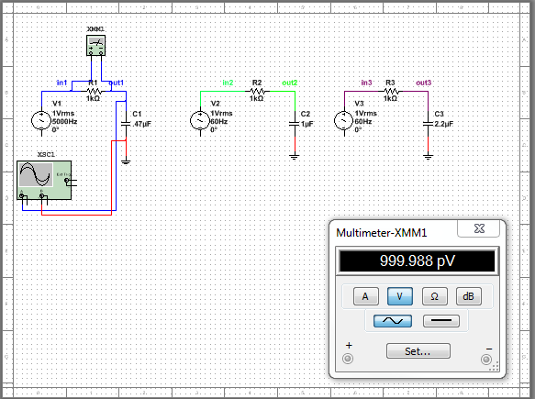
Multisim – Lab 11

Slide 36
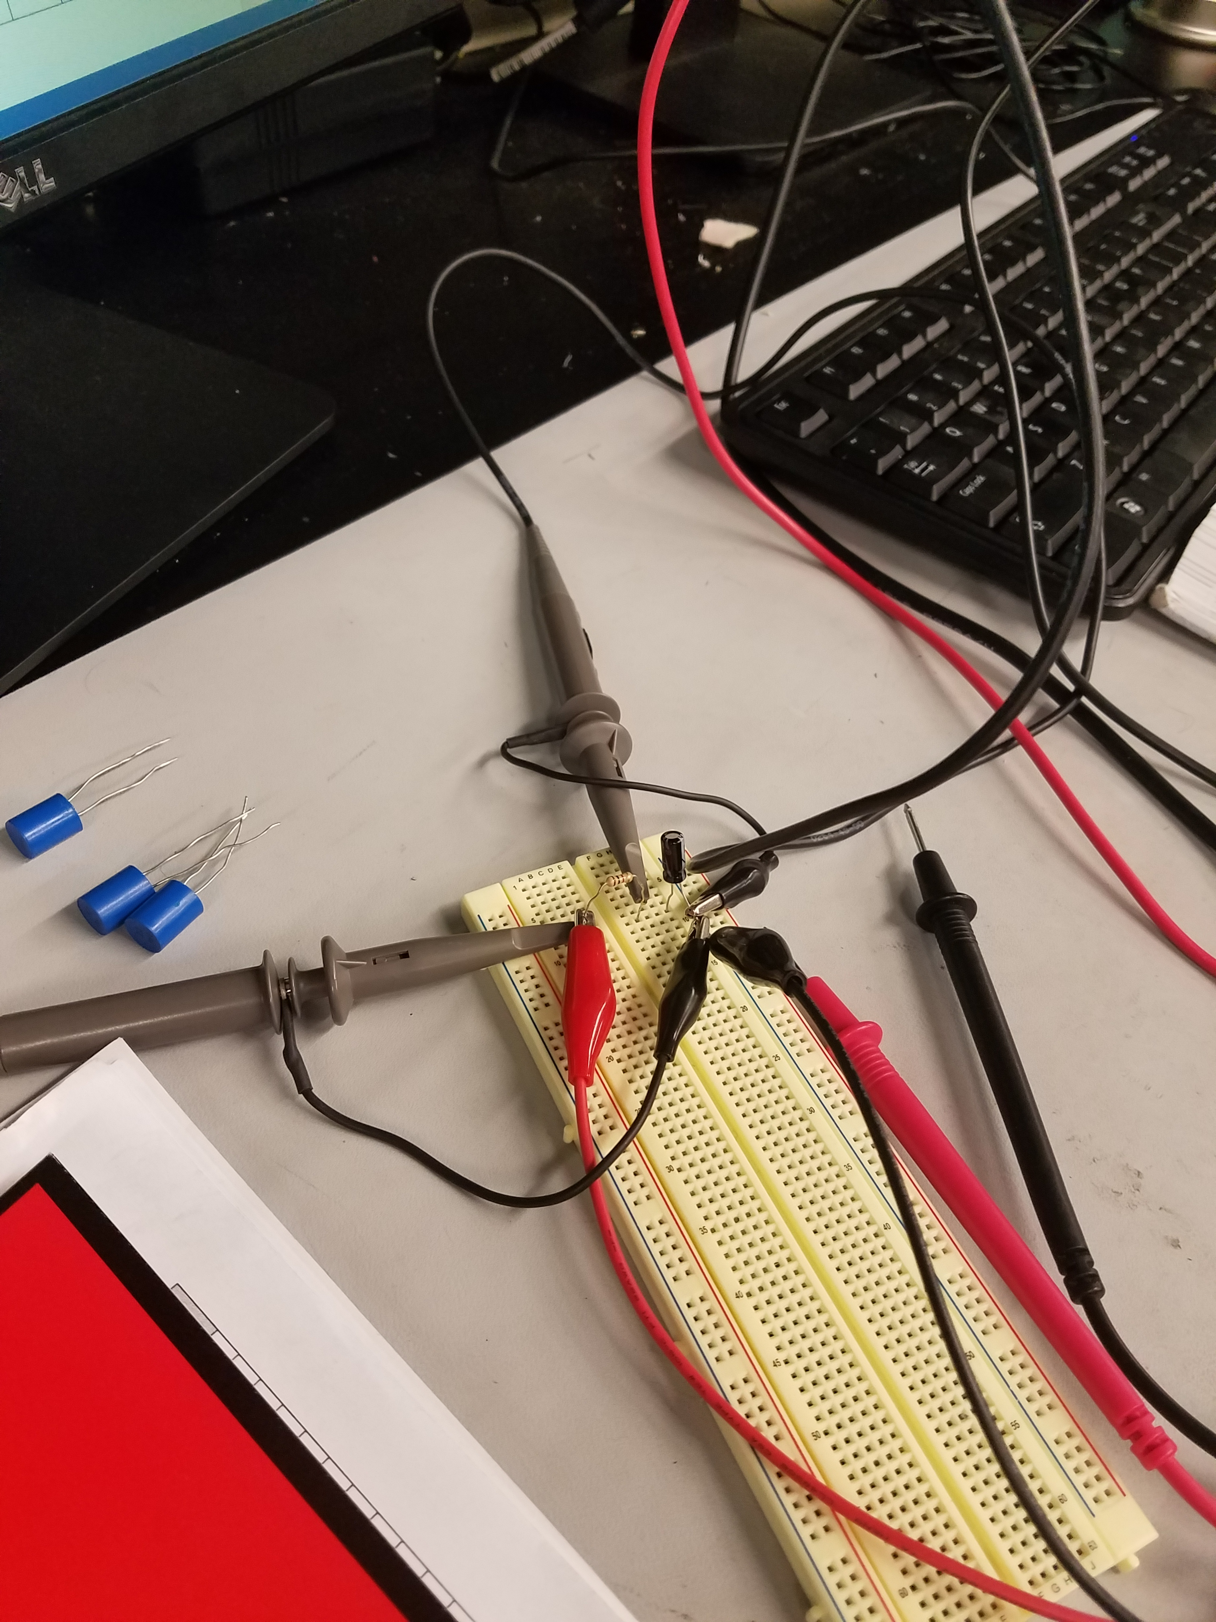
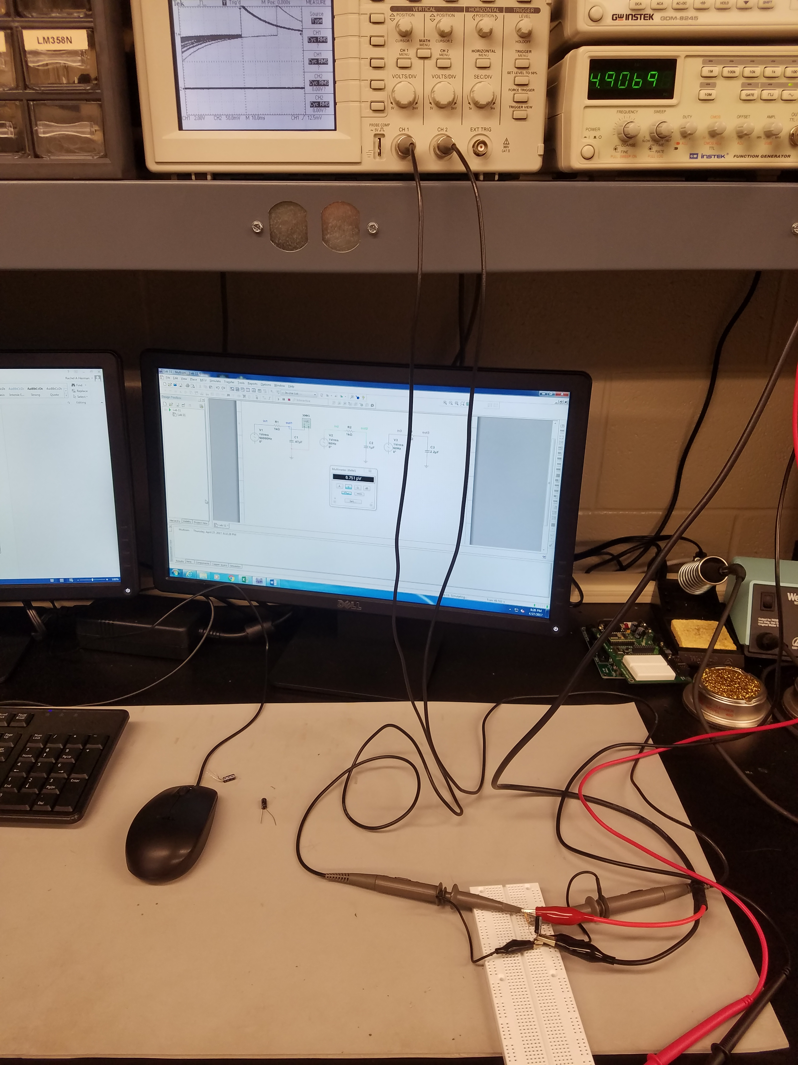
Pictures – Lab 11

Slide 37
Lab 12 – Series/Parallel Inductors
3/30/17
Jason Block, Rachel Herman
Purpose: Experiment with series circuits and parallel combinations of inductors.
Materials: 1 – LCR Meter – LCR-819, 1 each of the following: 1mH, 2.2mH and 4.7mH
Procedure: Measure and record the inductance of each inductor using the LCR meter. Connect the inductors as shown in Figure 1 and measure and record the total inductance, LT. Then connect the inductors as shown in Figure 2 and measure and record the total inductance, LT.

Slide 38

Figure 1
Figure 2
 | Expected | Simulated | Measured
L1 = | 1mH | 1mH | .944mH
L2 = | 2.2mH | 2.2mH | 2.188mH
L3 = | 4.7mH | 4.7mH | 4.342
LT = | .5997mH | .599mH | .599mH
Expected | Simulated | Measured
1mH | 1mH | .994mH
2.2mH | 2.2mH | 2.188mH
4.7mH | 4.7mH | 4.342mH
7.9mH | 7.9mH | 7.361mH
Observations: In this lab we measured the values of inductors using an LCR meter. We then set up the inductors in a series and parallel circuit. The measured values from the LCR meter were a bit lower than the expected values for the series and parallel circuits. The total value was a bit less than the expected value that we got from using equations from the book.

Slide 39
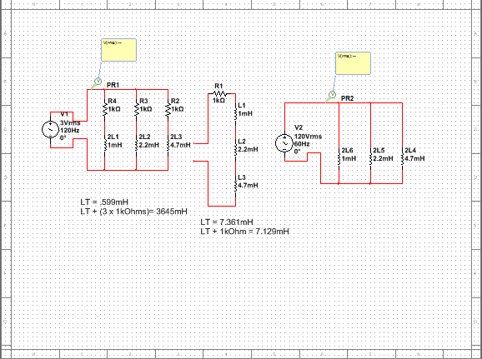
Multisim – Lab 12

Slide 40
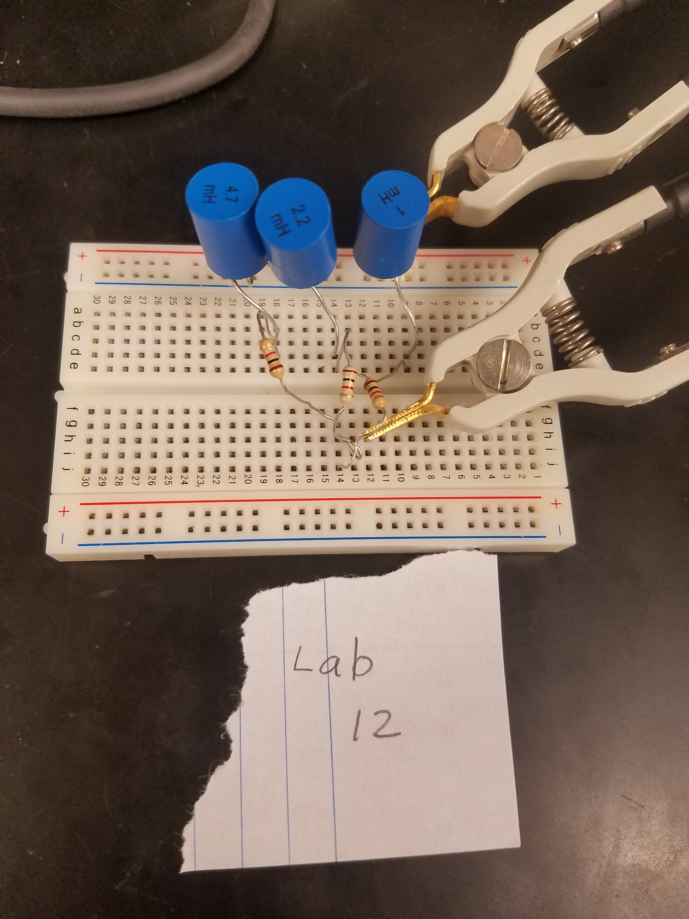
Pictures – Lab 12

Slide 41
Lab 13 – RL Lab
4/13/17
Jason Block, Rachel Herman
Purpose: Experiment with RL (Resistor & Inductor) circuits.
Materials: Digital Multimeter, LCR Meter – LCR-819, Oscilloscope – TDS-220, Function Generator – GFG-8210, 1 – 1kΩ resistor, 1 each of the following: 1mH, 2.2mH and 4.7mH
Procedure: Measure and record the resistor value using the DMM and measure and record the inductor values using the LCR meter in Table 1. Connect the resistor and inductor as shown in Figure 1. Connect the Function Generator to the input at V1 and connect Channel 1 of the Oscilloscope to the input and Channel 2 to the output. Adjust the voltage of the Function Generator to 1Vpp at the frequencies shown in Table 2. Measure the input and output voltages using the Oscilloscope. Record the results in Table 2. Change the inductor and retest.

Slide 42
Figure 1
 | Output Voltage L = __1 mH__ |  |  | Output Voltage L = _2.2 mH__ |  |  | Output Voltage L = _4.7 mH__
 | Expected | Measured |  | Expected | Measured |  | Expected | Measured
Frequency | Output Voltage | Input Voltage | Output Voltage | Output Voltage | Input Voltage | Output Voltage | Output Voltage | Input Voltage | Output Voltage
10 | 0.00006 V | 1.0587 V | 0.00006 V | 0.00014 V | 1.0587 V | 0.00012 V | 0.00030 V | 1.0587 V | 0.00029 V
50 | 0.00031 V | 1.0587 V | 0.00028 V | 0.00069 V | 1.0587 V | 0.00060 V | 0.00148 V | 1.0587 V | 0.00144 V
100 | 0.00063 V | 1.0587 V | 0.00057 V | 0.00138 V | 1.0587 V | 0.00119 V | 0.00295 V | 1.0587 V | 0.00288 V
200 | 0.00126 V | 1.0587 V | 0.00113 V | 0.00276 V | 1.0587 V | 0.00239 V | 0.00590 V | 1.0587 V | 0.00575 V
300 | 0.00188 V | 1.0587 V | 0.00170 V | 0.00414 V | 1.0587 V | 0.00358 V | 0.00885 V | 1.0587 V | 0.00863 V
400 | 0.00251 V | 1.0587 V | 0.00226 V | 0.00553 V | 1.0587 V | 0.00477 V | 0.01181 V | 1.0587 V | 0.01150 V
500 | 0.00314 V | 1.0587 V | 0.00283 V | 0.00691 V | 1.0587 V | 0.00597 V | 0.01476 V | 1.0587 V | 0.01438 V
600 | 0.00377 V | 1.0587 V | 0.00339 V | 0.00829 V | 1.0587 V | 0.00716 V | 0.01771 V | 1.0587 V | 0.01725 V
700 | 0.00440 V | 1.0587 V | 0.00396 V | 0.00967 V | 1.0587 V | 0.00835 V | 0.02066 V | 1.0587 V | 0.02013 V
800 | 0.00502 V | 1.0587 V | 0.00452 V | 0.01105 V | 1.0587 V | 0.00955 V | 0.02361 V | 1.0587 V | 0.02300 V
900 | 0.00565 V | 1.0587 V | 0.00509 V | 0.01243 V | 1.0587 V | 0.01074 V | 0.02656 V | 1.0587 V | 0.02588 V
1,000 | 0.00628 V | 1.0587 V | 0.00565 V | 0.01381 V | 1.0587 V | 0.01193 V | 0.02950 V | 1.0587 V | 0.02875 V
2,000 | 0.01256 V | 1.0587 V | 0.01130 V | 0.02762 V | 1.0587 V | 0.02386 V | 0.05893 V | 1.0587 V | 0.05743 V
3,000 | 0.01884 V | 1.0587 V | 0.01695 V | 0.04141 V | 1.0587 V | 0.03577 V | 0.08820 V | 1.0587 V | 0.08597 V
4,000 | 0.02511 V | 1.0587 V | 0.02260 V | 0.05518 V | 1.0587 V | 0.04767 V | 0.11725 V | 1.0587 V | 0.11430 V
5,000 | 0.03138 V | 1.0587 V | 0.02825 V | 0.06892 V | 1.0587 V | 0.05955 V | 0.14600 V | 1.0587 V | 0.14235 V
6,000 | 0.03765 V | 1.0587 V | 0.03389 V | 0.08261 V | 1.0587 V | 0.07141 V | 0.17438 V | 1.0587 V | 0.17006 V
7,000 | 0.04392 V | 1.0587 V | 0.03953 V | 0.09626 V | 1.0587 V | 0.08323 V | 0.20234 V | 1.0587 V | 0.19738 V
8,000 | 0.05018 V | 1.0587 V | 0.04517 V | 0.10986 V | 1.0587 V | 0.09502 V | 0.22981 V | 1.0587 V | 0.22424 V
9,000 | 0.05643 V | 1.0587 V | 0.05080 V | 0.12339 V | 1.0587 V | 0.10677 V | 0.25674 V | 1.0587 V | 0.25060 V
10,000 | 0.06268 V | 1.0587 V | 0.05643 V | 0.13686 V | 1.0587 V | 0.11848 V | 0.28309 V | 1.0587 V | 0.27642 V
 | Inductance or Resistance
 | Expected | Measured
L1 = | 1 mH | 1.128 mH
L2 = | 2.2 mH | 2.412 mH
L3 = | 4.7 mH | 4.805 mH
R1 = | 100 Ω | 98.76 Ω
Observations: In this lab we measured our resistor and our inductors first off. Then we placed them in a simple series circuit and hooked it up to the function generator and the oscilloscope. An issue that we ran into for quite a while was figuring out how to manipulate and read the function generator and oscilloscope. Alas, we finally figured it out and were able to measure and record the output voltages.

Slide 43
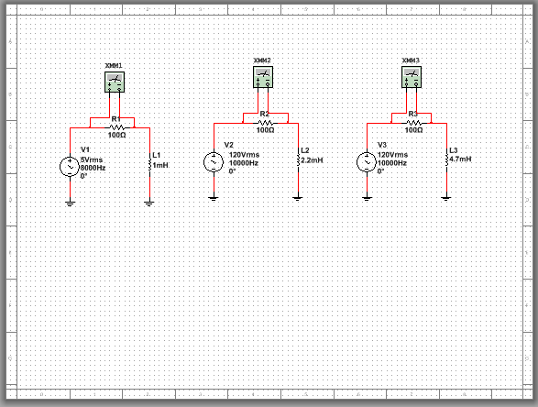
Multisim – Lab 13

Slide 44
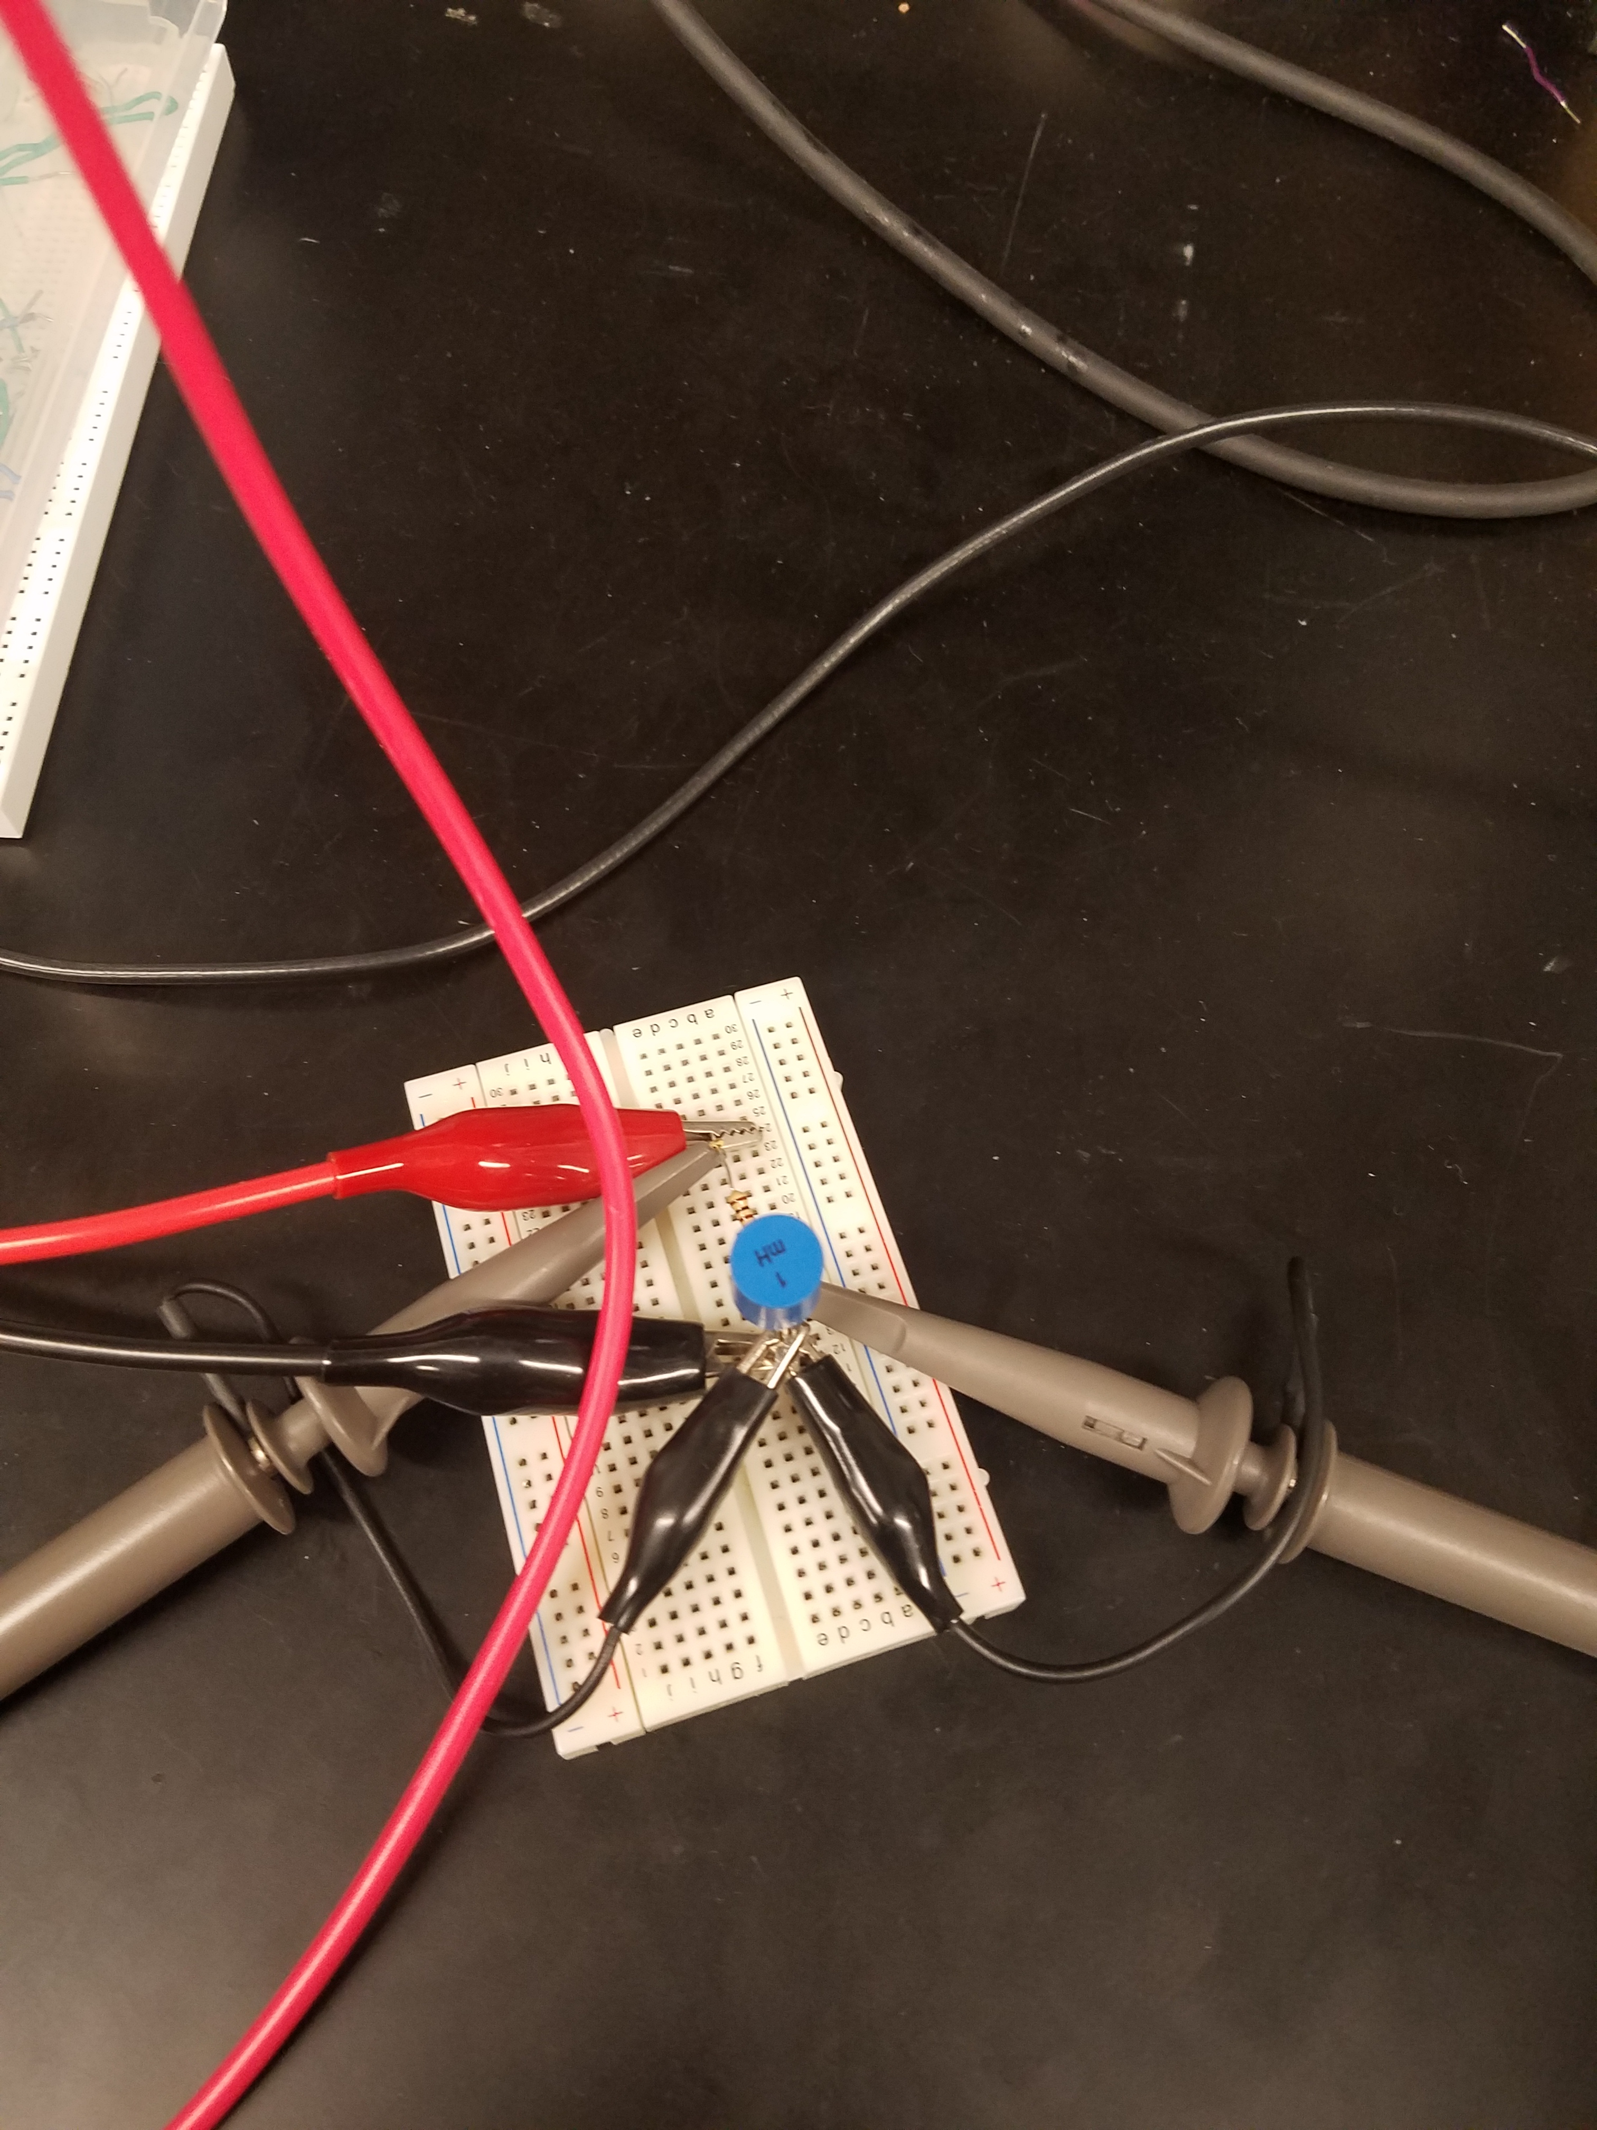
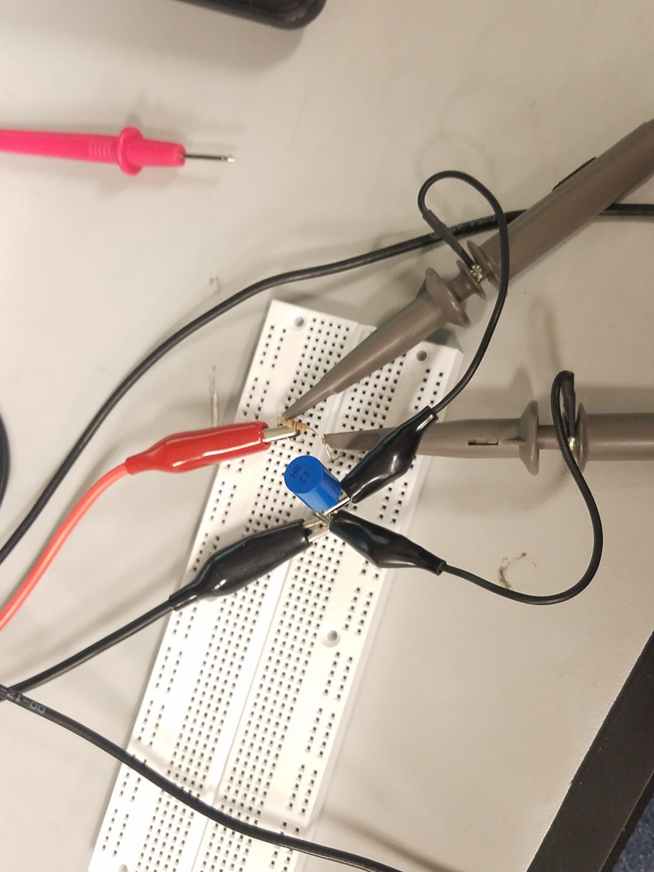
Pictures – Lab 13

